Slide 1
Modes of transfer
Data transfer between computer and IO device can
be handle in the following ways:
  Programmed IO
  Interrupt-Initiated IO
  Direct Memory Access(DMA)

Slide 2
Programmed IO
Each data transfer is initiated by an instruction in
the program.
CPU stays in the program loop until IO unit indicates it is ready for the data transfer.
It is time consuming process since it keeps processor
busy needlessly.

Slide 3
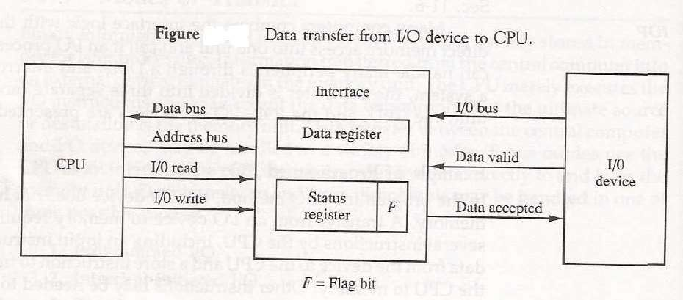
Example of programmed IO

Slide 4
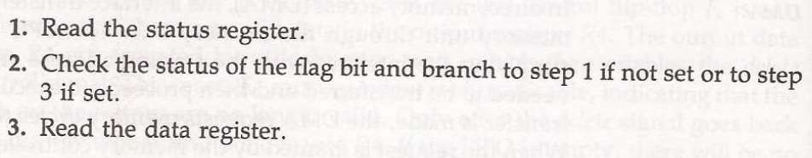
The transfer of data requires three instructions:

Slide 5
Interrupt Initiated IO
In this type of IO, computer does not check the flag.
It continue to perform its task.
Whenever any device wants the attention, it sends the interrupt signal to the CPU.
CPU then deviates from what it was doing, store the return address from PC and branch to the address of the subroutine.

Slide 6
There are two ways of choosing the branch address:
Vectored Interrupt
Non-vectored Interrupt
In vectored interrupt the source that interrupt the CPU provides the branch information. This information is called interrupt vectored.
In non-vectored interrupt, the branch address isassigned to the fixed address in the memory.

Slide 7
Priority Interrupt
There are number of IO devices attached to the
computer.
They are all capable of generating the interrupt.
When the interrupt is generated from more than one device,priority interrupt system is used to determine which device is to be serviced first.
Devices with high speed transfer are given higher
priority and slow devices are given lower priority.

Slide 8
Establishing the priority can be done in two ways:
Using Software
Using Hardware
A pooling procedure is used to identify highest
priority in software means.

Slide 9
Polling Procedure
There is one common branch address for all
interrupts.
Branch address contain the code that polls the interrupt sources in sequence. The highest priority is tested first.
The particular service routine of the highest priority device is served.
The disadvantage is that time required to poll them can exceed the time to serve them in large number of IO devices.

Slide 10
Using Hardware
Hardware priority system function as an overall
manager.
It accepts interrupt request and determine the priorities.
To speed up the operation each interrupting devices
has its own interrupt vector.
No polling is required, all decision are established by hardware priority interrupt unit.
It can be established by serial or parallel connection of interrupt lines.

Slide 11
Serial or Daisy Chaining Priority.
Device with highest priority is placed first.
Device that wants the attention send the interrupt request to the CPU.
CPU then sends the INTACK signal which is applied to PI(priority in) of the first device.
If it had requested the attention, it place its VAD(vector address) on the bus. And it block the signal by placing 0 in PO(priority out)

Slide 12
If not it pass the signal to next device through
PO(priority out) by placing 1.
This process is continued until appropriate device is found.
The device whose PI is 1 and PO is 0 is the device
that send the interrupt request.

